Slide 1
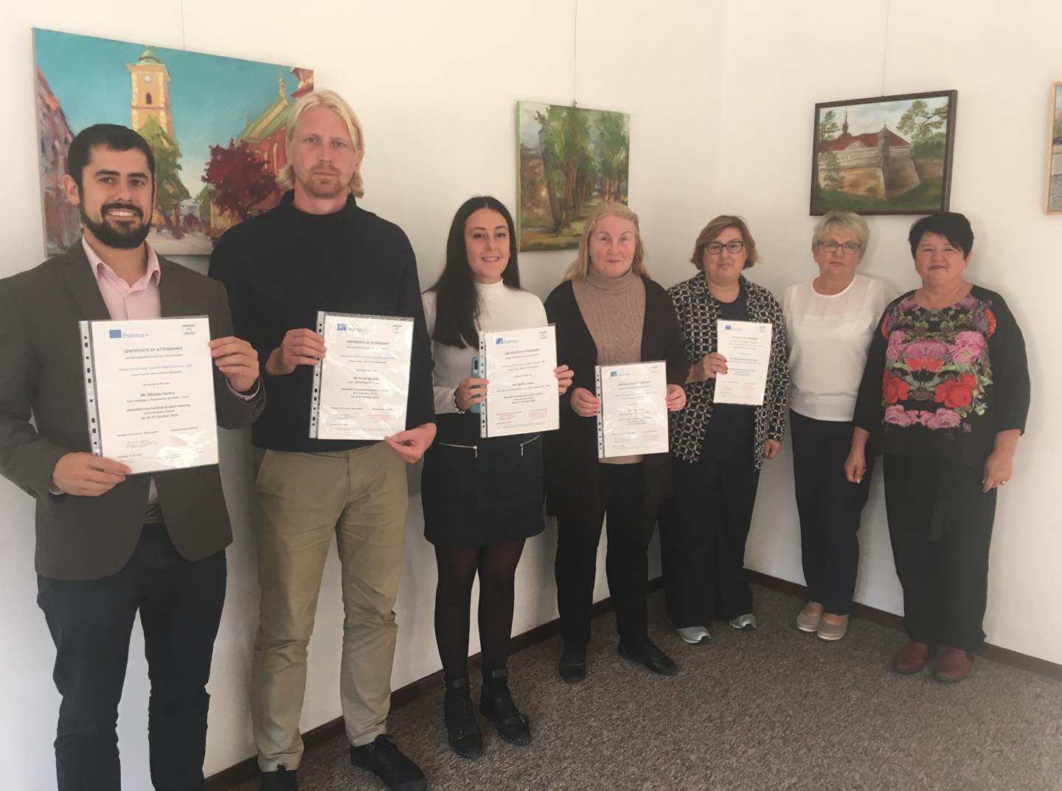
Erasmus+ strategic partnership project
"Digital Storytelling Tools
for Adult Educators“
2019-1-PL01-KA204-065676
Kick-off meeting in Poland,
October 26-27, 2019
The European Commission's support for the production of this publication does not constitute an endorsement of the contents, which reflect the views only of the authors, and the Commission cannot be held responsible for any use which may be made of the information contained therein.

Slide 2
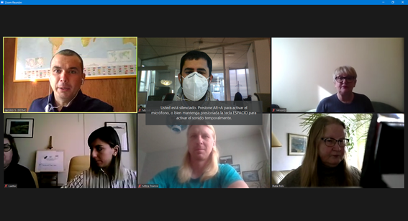
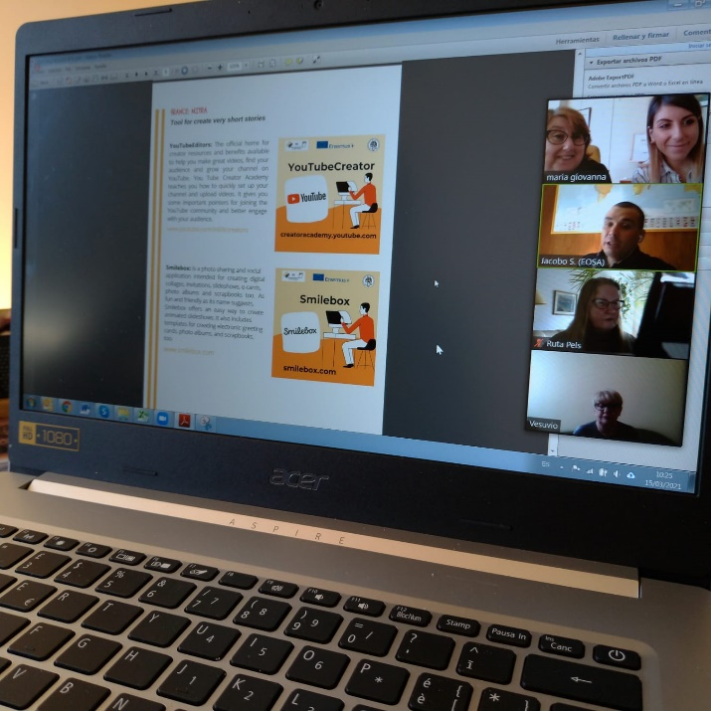
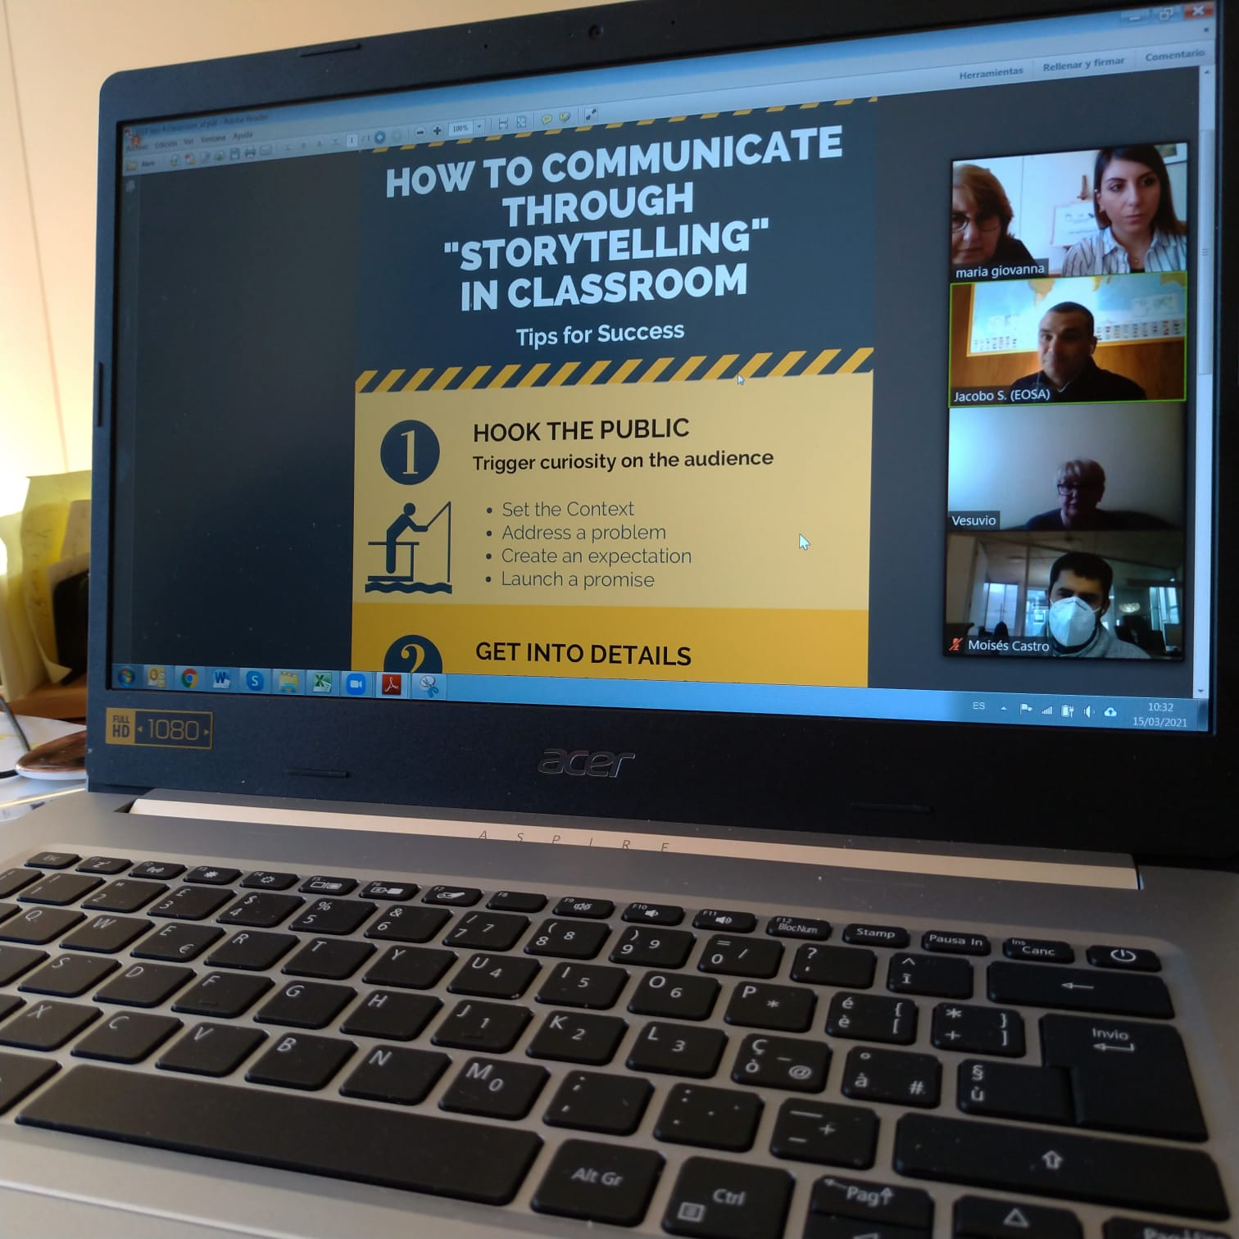
Online meetings Work on project materials with project partners

Slide 3
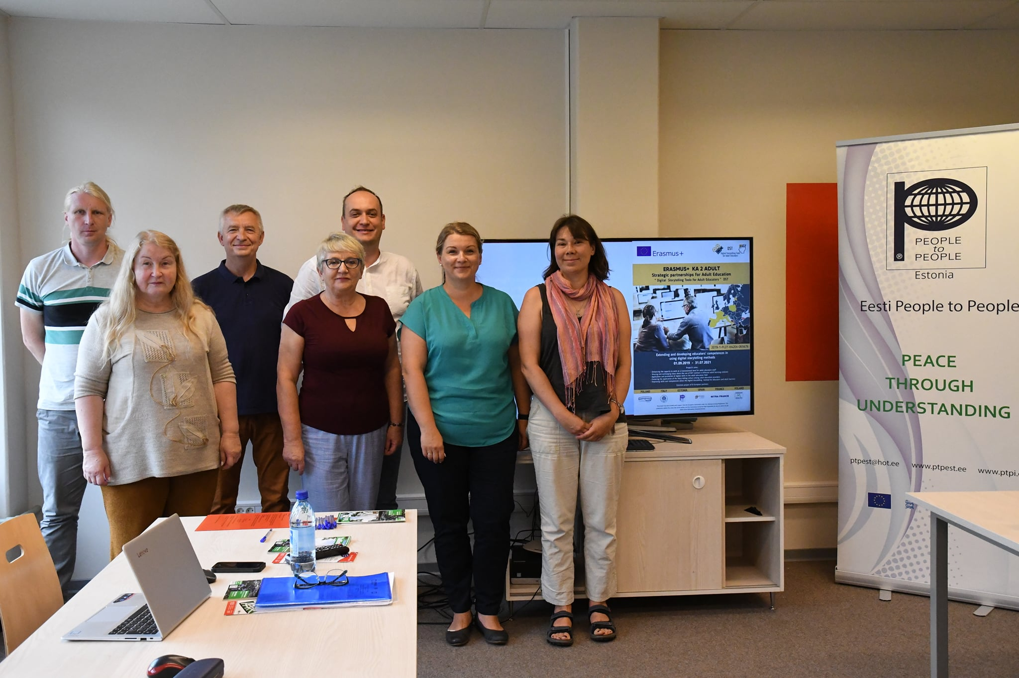
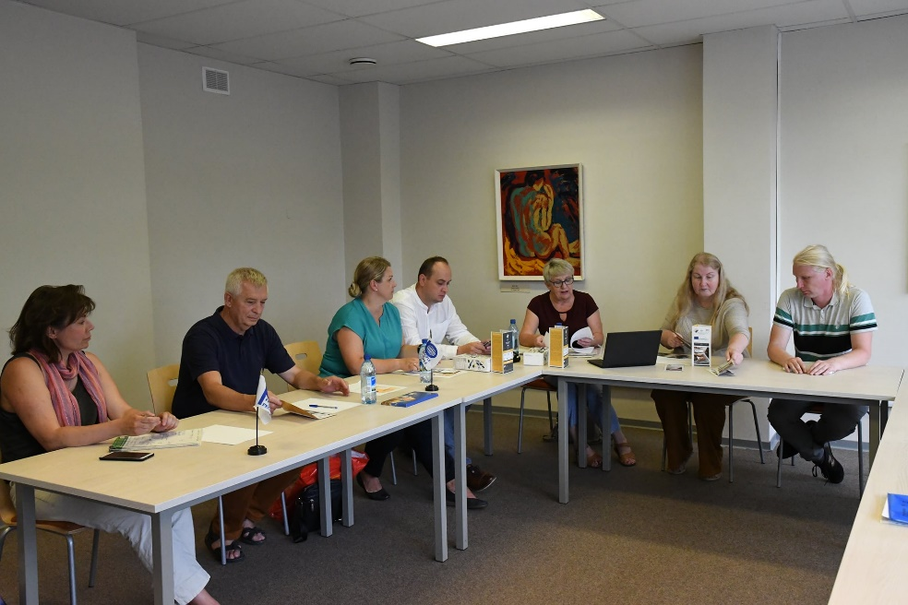
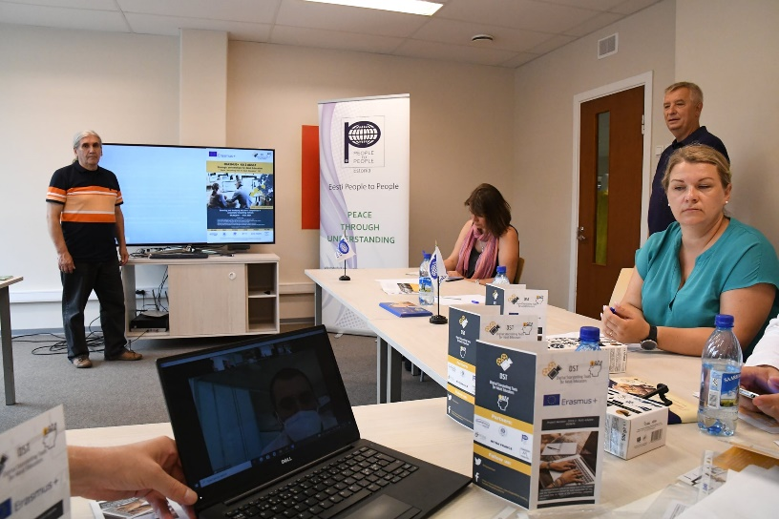
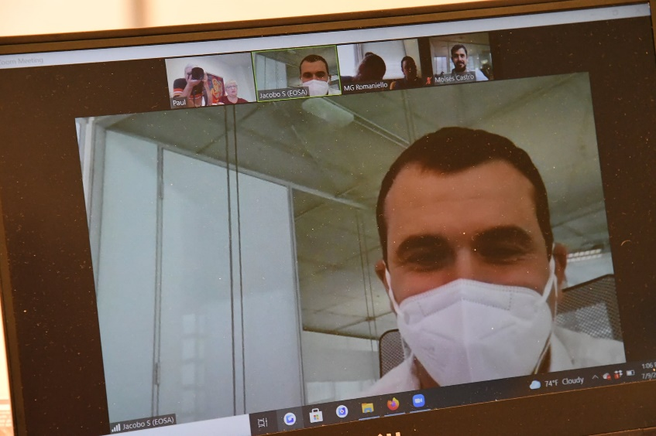
Transnational project meeting Estonia, July 9, 2021 Partners discussed ongoing activities and preparation to the short-term joint staff training event.

Slide 4
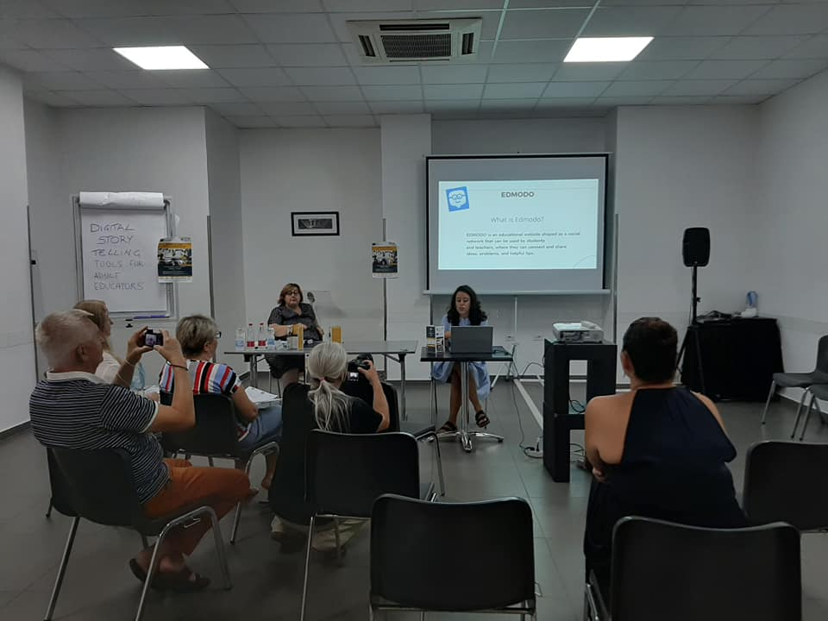
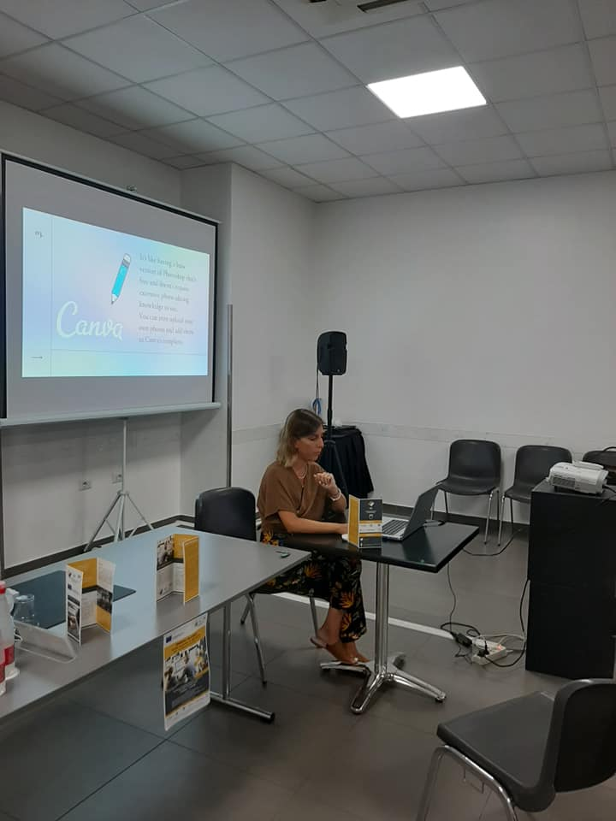
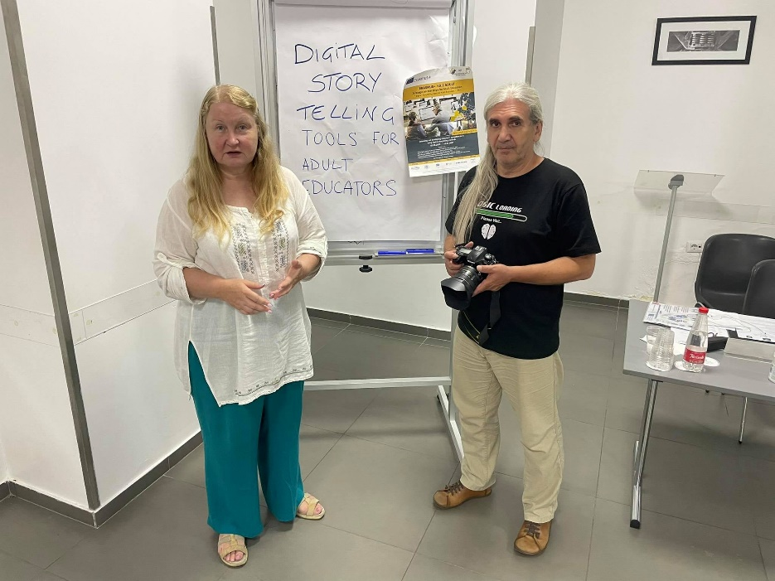
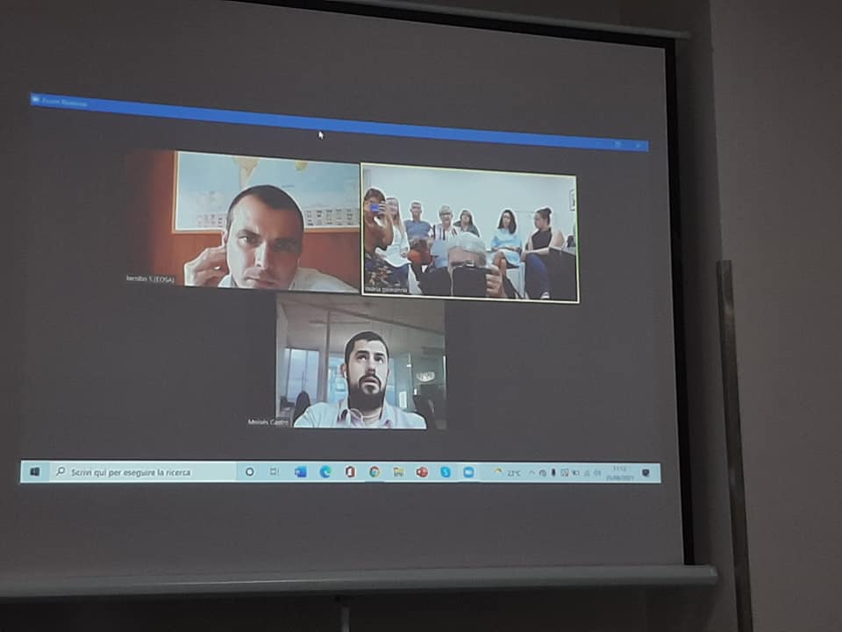
Short-term joint staff training event Italy, August 24-28, 2021
Presentations about digital tools useful for storytelling by LUETEC, MITRA FRANCE and EESTI PEOPLE TO PEOPLE trainers.
Blended activities with Spanish partners during the training course. Planning about project video-lessons.

Slide 5
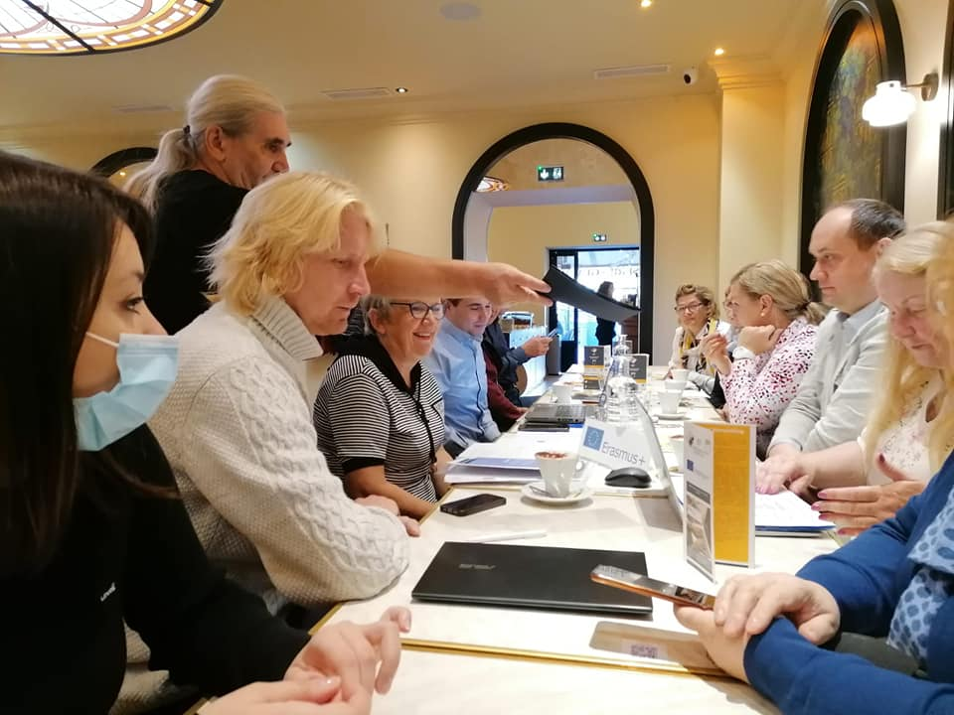
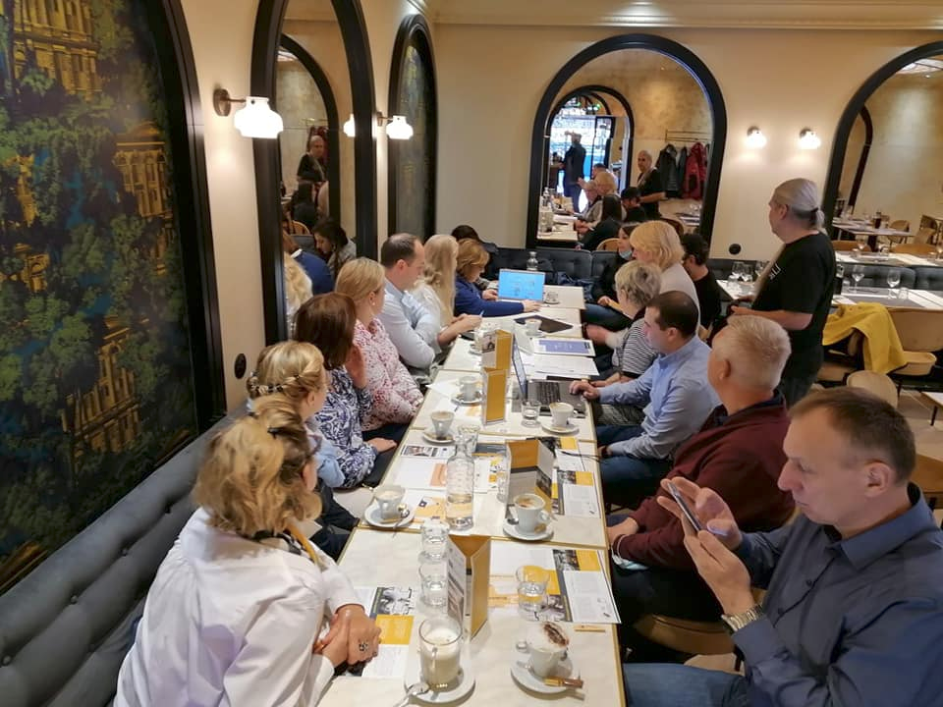
Final transnational project meeting France, November 4-5, 2021

Slide 6
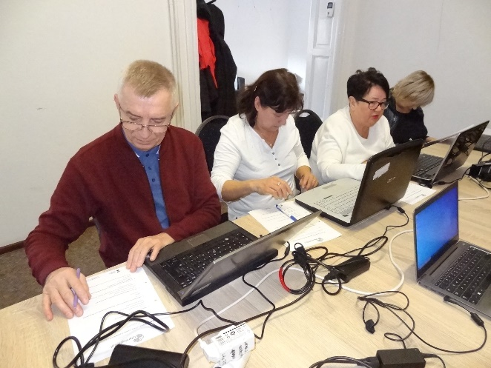
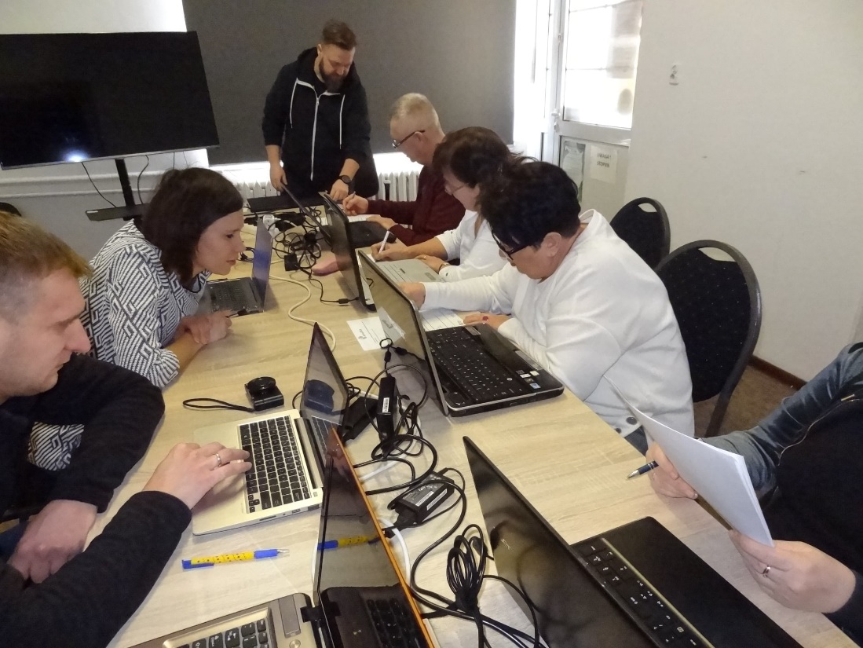
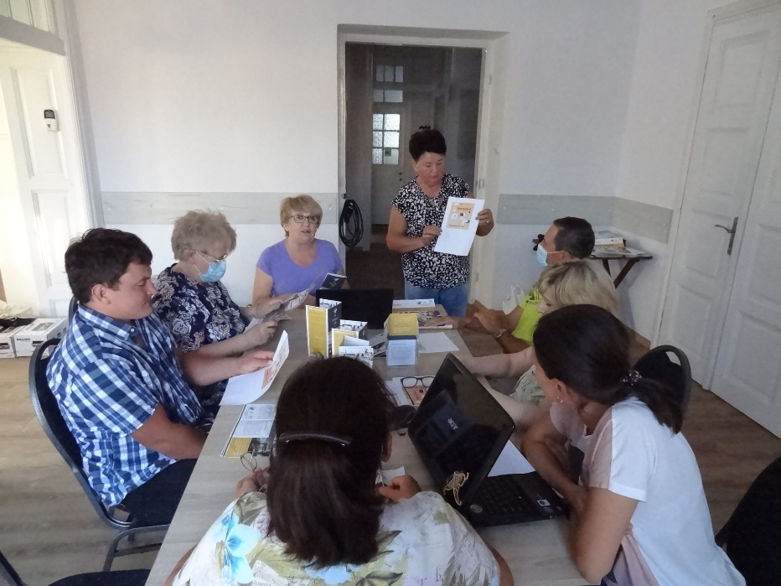
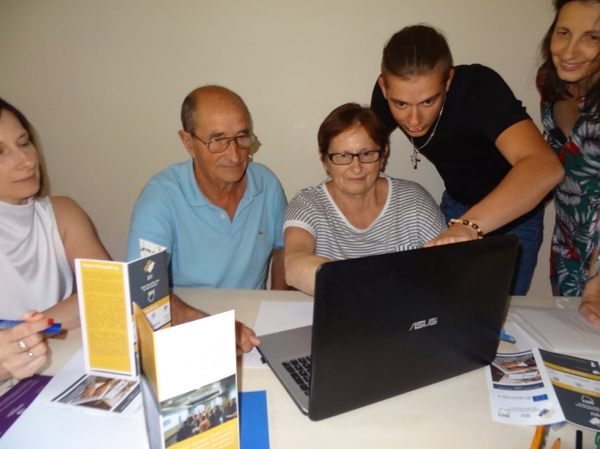
Local activities Creation and testing project materials with educators and learners

Slide 7
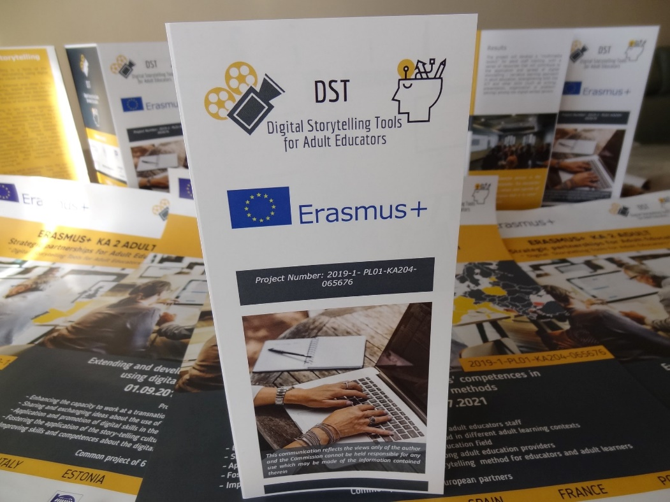
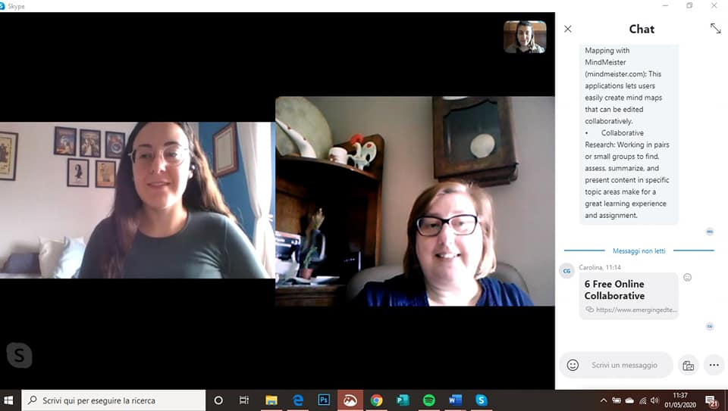
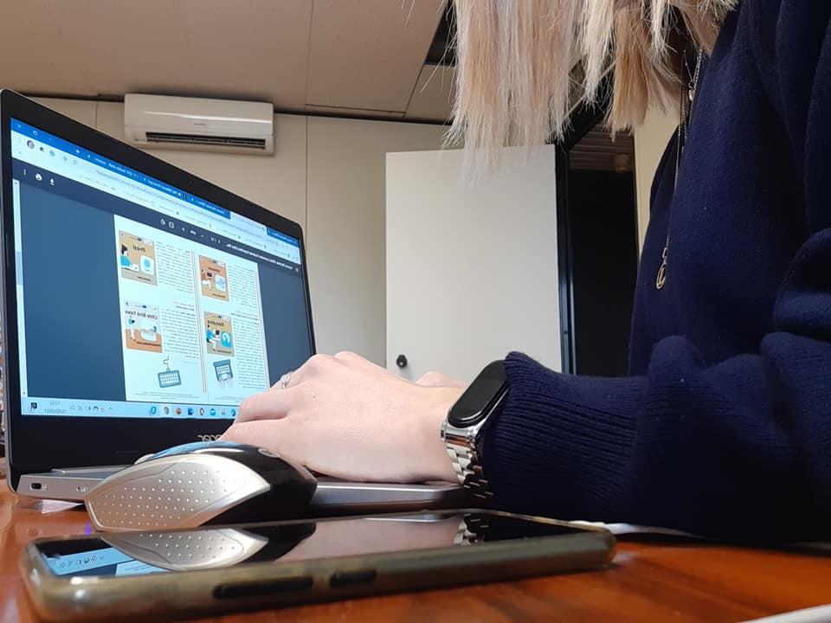
Work on project materials offline and online

Slide 9
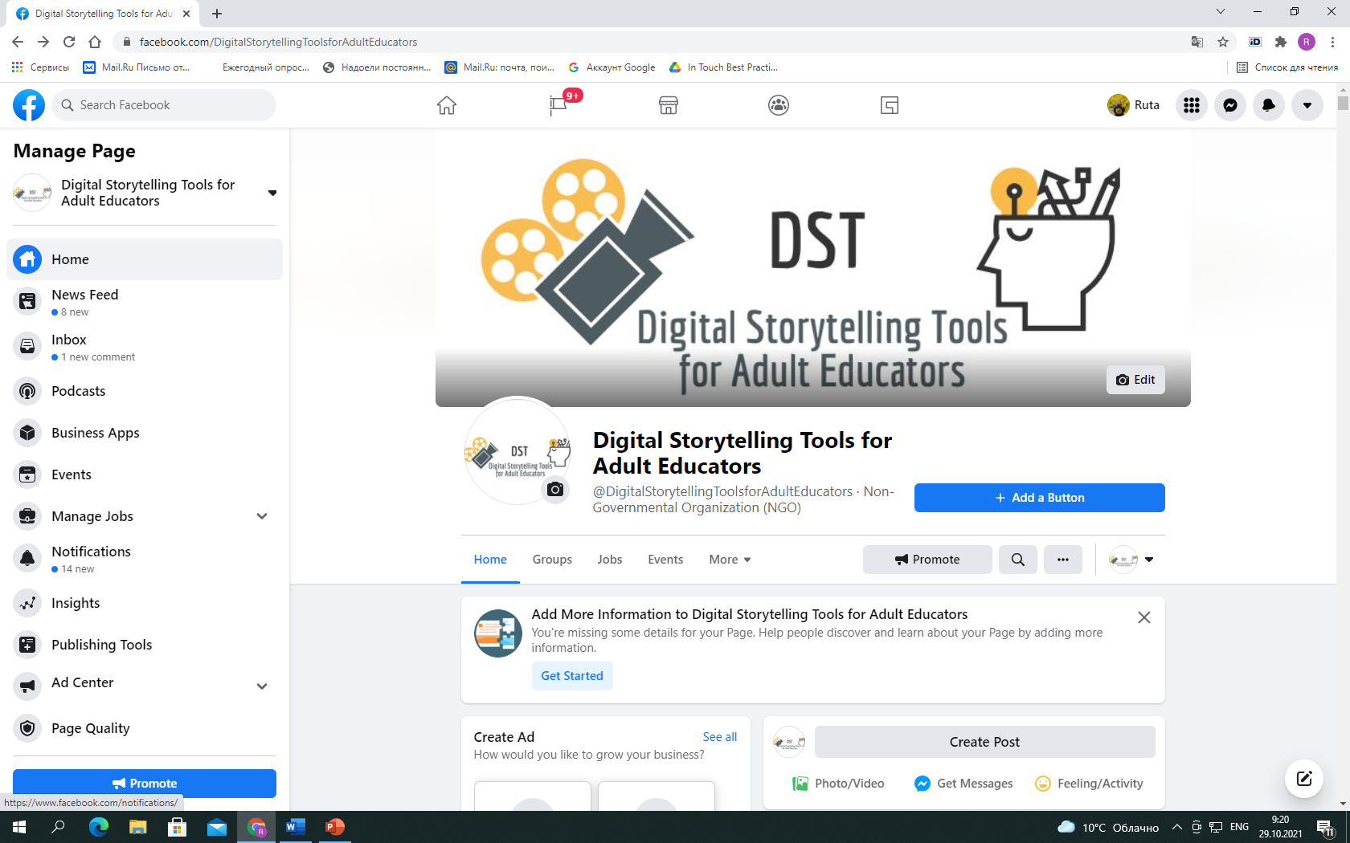
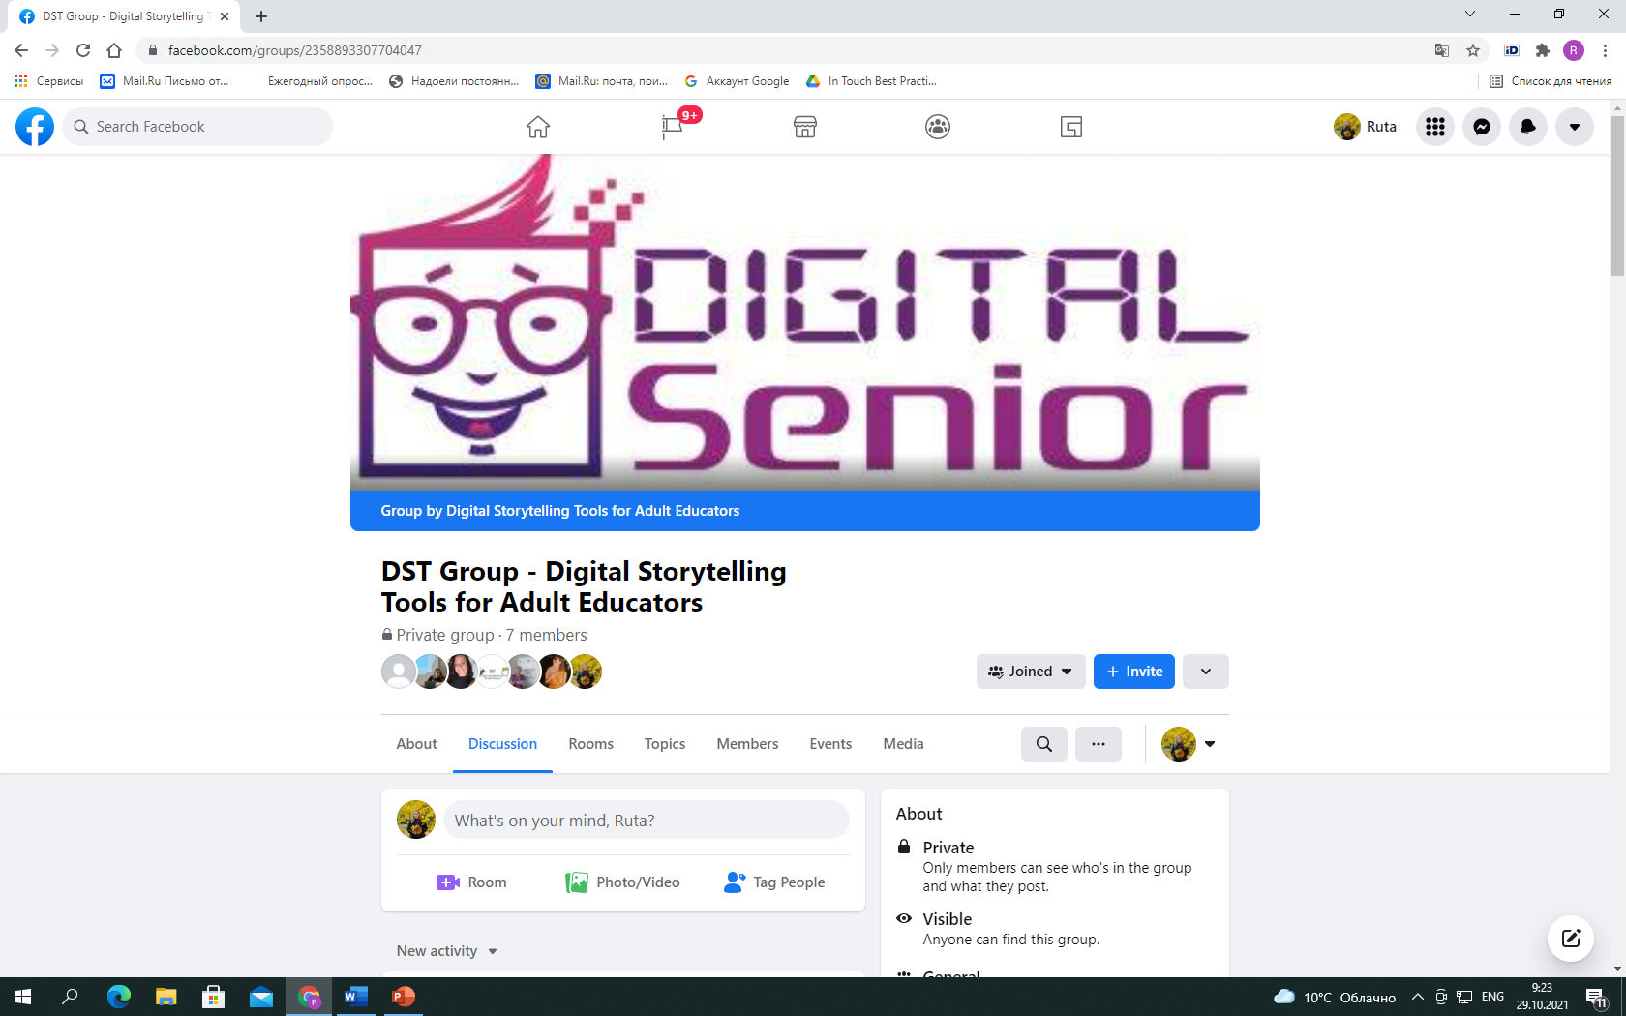
Project Facebook page
https://www.facebook.com/DigitalStorytellingToolsforAdultEducators
and Facebook group
https://www.facebook.com/groups/2358893307704047

